Slide 1
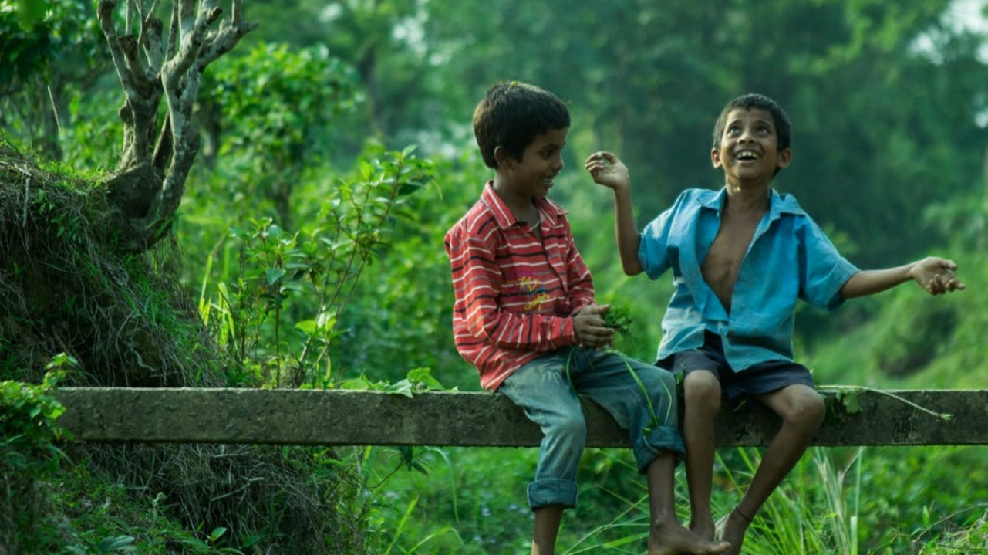

YEARS 7&8 | KS3| Ages 11-13
CHANGING CLIMATES
EXPLORING THE NATURAL WORLD

Slide 2
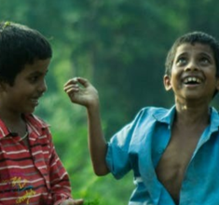

Y7&8 | AGES 11-13
AT A GLANCE | CHANGING CLIMATES| The Ripple Effects
30 minutes
THE RIPPLE EFFECTS: Understand the impacts of climate change by empathising with non-human species through a panel debate where each student will take on a role.
Only got 45 minutes?
We recommend exploring the first section, one image from the second section in terms of impact on humans and non-humans, and the third section.
Only got 30 minutes?
We recommend exploring the second and third sections.
20 minutes
THE WIDER IMPACT: Understand the impacts of climate change in different communities around the world and other ripple effects through images and information.
10 minutes
ECO-EMPATHY: Reflecting on ‘eco-anxiety’/‘eco-empathy’ and the power of small/individual actions so as to recognise the emotions that may have arisen in the lesson and to prepare for Lesson 4.
© ThoughtBox Education 2023-4

Slide 3
In this lesson you will need:
Here is a list of resources you will need for this lesson.
Internet access
Speakers
Pens or pencils
ThoughtBox Thought-Books or paper
Information sheets for panel discussion (click here to print)
*We recommend using a journal-style book for ThoughtBox lessons, in order to capture notes, ideas, drawings, reflections, inspiration and learnings.

Slide 4
CHANGING CLIMATES
THE RIPPLE EFFECTS
60 MINUTES

Slide 5

In this lesson, we will:
Understand and explore some of the feelings and emotions that climate change may encourage.
Think about and discuss the impacts of climate change on the human and non-human world.
Explore how our own actions can have ripple effects and consequences and how this can help us to feel empowered.

Slide 6
THE RIPPLE
EFFECTS
30 MINUTES

Slide 7
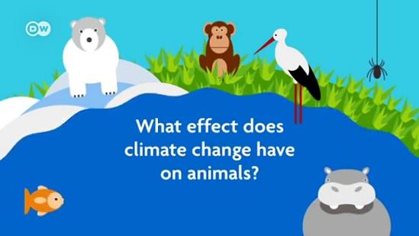
Take a look at the short video (2:12 minutes) made by German news organisation DW which asks the question:
How does climate change affect animals?
(Click on the link above for the hyperlink)
Notes:
Video URL: https://www.youtube.com/watch?v=9h7P8gWpolQ

Slide 8
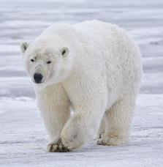
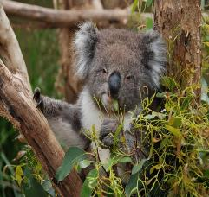
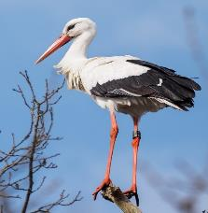
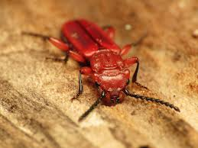
Global warming and climate change is leading to changes in vegetation across the world, such as forcing many animal species to migrate and look for cooler habitats.
Some of the species adapting to climate change mentioned in the video were:
What do you remember about these creatures and their adaptations?

Slide 9

Although global warming and human-caused climate change have negative ripple effects for many species of plants, animals and humans, there are some who directly benefit.
For example the Bark Beetle.
What were the ripple effects of global warming on the bark beetle?

Slide 10
We’re now going to explore how some creatures and habitats are affected by climate change through a creative exercise.
Working in groups of five or six, you’re going to hold a panel debate with several global experts to discuss the impact of the climate crisis.
Each of you in your group will choose one of the character roles in the following slide.
This will be your character for the discussion and you will talk as though you were this expert.

Slide 11

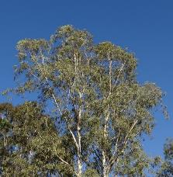
The interviewer
A polar bear
A bark beetle
A koala bear
A eucalyptus tree
A stork
Instructions continue on the next slide.

Slide 12

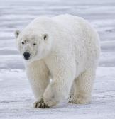




Planning and preparation:
The interviewer will hold a general discussion with the group, asking a series of questions to each of the panellists and also allowing for a general discussion amongst the group.
Take five minutes to read the information sheet for your character to help you to get into your role and prepare for your discussion.
*Click on the image to download the fact sheet.

Slide 13
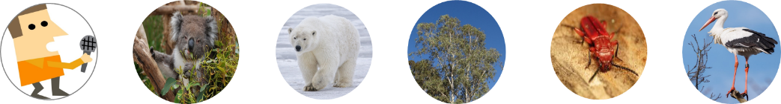
The panel debate: The impacts of climate change:
Working in groups, you are all now going to hold your panel discussion on the climate crisis, talking amongst the characters* at your table.
*Remember to stay in character talk as though you were this expert!
NB: Make sure you listen carefully to what each panellist has to say – it could be helpful to make notes as they are talking so you can respond to their points in your own discussions.

Slide 14
After the discussion, have one person from each group share some reflections from their group.
How was this experience for you?

Slide 15
THE WIDER IMPACT
20 MINUTES

Slide 16
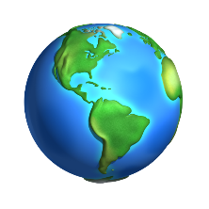

We learned from the earlier video that some creatures are having to adapt to changing climates by moving, migrating or fleeing areas which are no longer habitable for them.
We are also seeing this same pattern in human behaviour, as different communities across the world are having to adapt to climate change and move, migrate or flee from the impact on their local contexts.
Species are moving on average 17km further north or south in the world to find cooler climates every 10 years.
Species are moving on average 11km higher up in their environments to find cooler climates every 10 years.

Slide 17
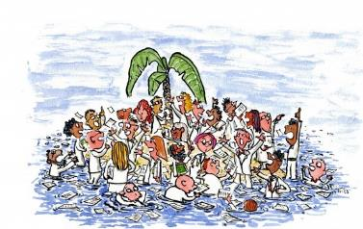
Do you know of any cases of humans moving because of climate change?
Think about some examples as a class.

Slide 18

There are already millions of climate migrants across the world – people having to adapt to the changing climate and move to cooler, safer or more fertile areas to live.
We have been seeing the impact of this for several years in sub-Saharan Africa, South Asia, and Latin America, but it is now impacting people and communities in countries across the world in both the Global North and Global South.
Explore more about the subject of migration in the ThoughtBox topic ‘Refugee Journeys’

Slide 19
In pairs, take a couple of moments to discuss the following question:
Why are people having to leave their homes because of the climate?
How do you think it would feel to have to leave your home?
Explore more about the subject in the ThoughtBox topic ‘Home’

Slide 20
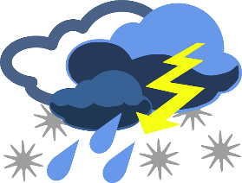
Extreme weather is becoming much more common across the planet. Changes in climate due to human actions are caused by many of humans’ habits, but the use of fossil fuels is one of the biggest culprits.
Many people are leaving home because of flooding or soil erosion, dying crops, drought or extreme weather conditions.

Slide 21
Take a look at the following ten images which show recent cases of extreme weather in countries and communities across the world, in both the Global North and Global South.
For each image, think about any of the similarities that you can see to where you live in the world – how familiar are the people or the landscape or the objects or the areas in these images?
For each image, reflect on how it makes you feel.

Slide 22
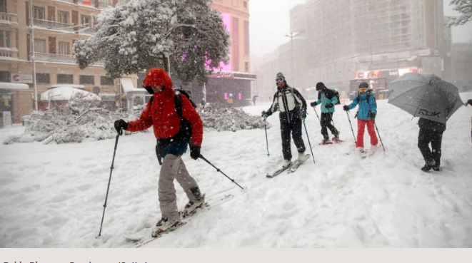
Record-breaking snowfall Madrid, Spain

Slide 23
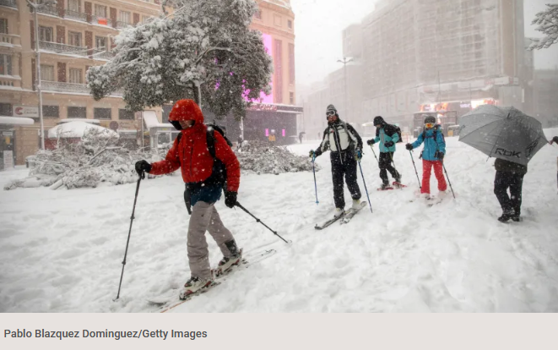
Are there any of the similarities that you can see to where you live in the world?
How familiar are the people, the landscape, the objects or the areas in these images?
How does this image make you feel?

Slide 24
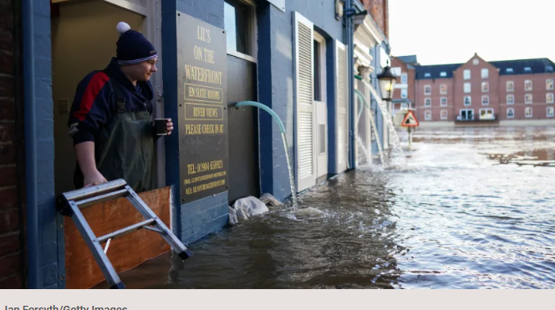
Storm Christoph
United Kingdom

Slide 25
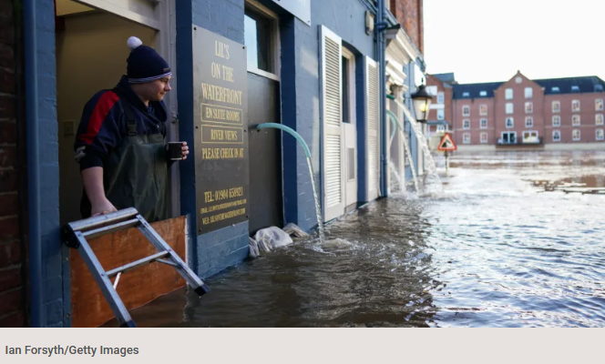
Are there any of the similarities that you can see to where you live in the world?
How familiar are the people, the landscape, the objects or the areas in these images?
How does this image make you feel?

Slide 26
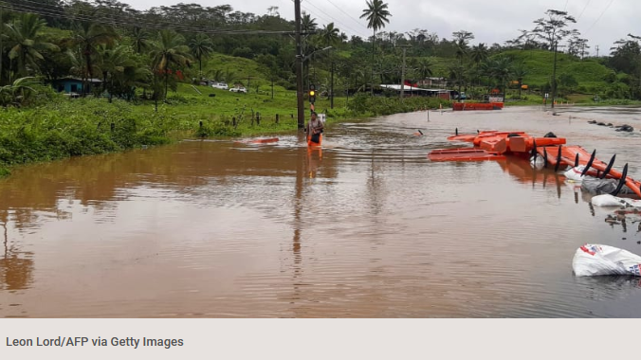
Cyclone Ana
Fiji

Slide 27
Are there any of the similarities that you can see to where you live in the world?
How familiar are the people, the landscape, the objects or the areas in these images?
How does this image make you feel?

Slide 28
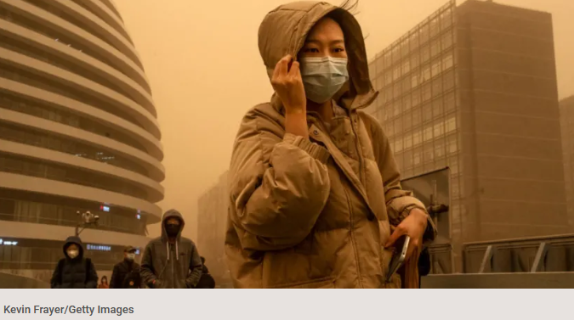
Dust storm
China

Slide 29
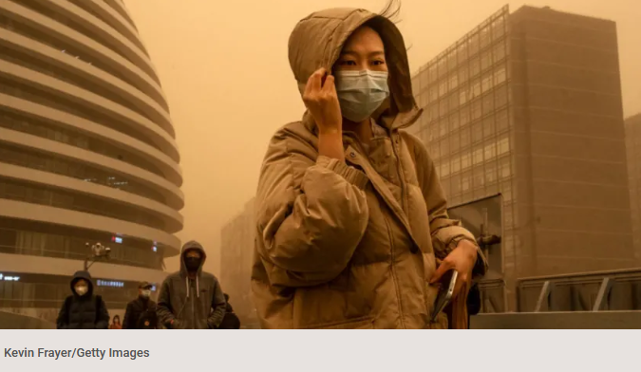
Are there any of the similarities that you can see to where you live in the world?
How familiar are the people, the landscape, the objects or the areas in these images?
How does this image make you feel?

Slide 30
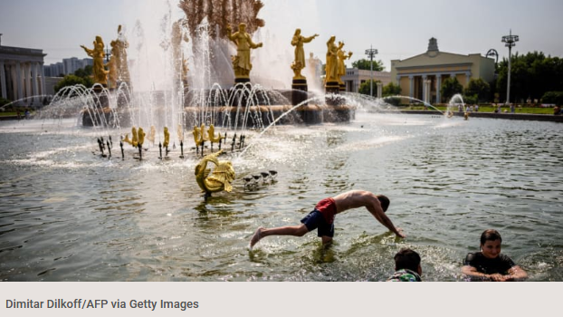
Record temperatures
Moscow

Slide 31
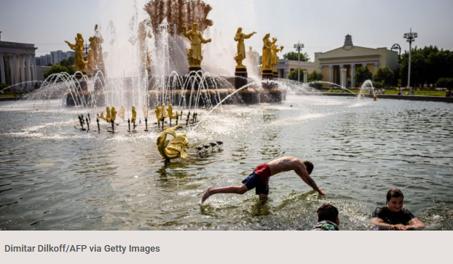
Are there any of the similarities that you can see to where you live in the world?
How familiar are the people, the landscape, the objects or the areas in these images?
How does this image make you feel?

Slide 32
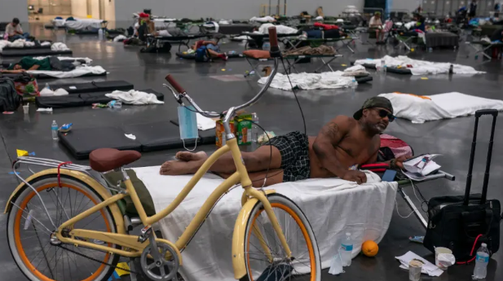
Heat dome
Pacific Northwest

Slide 33
Are there any of the similarities that you can see to where you live in the world?
How familiar are the people, the landscape, the objects or the areas in these images?
How does this image make you feel?

Slide 34
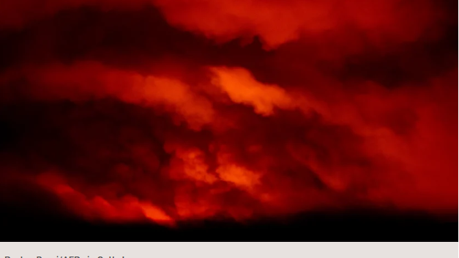
Bootleg fire
Oregon

Slide 35
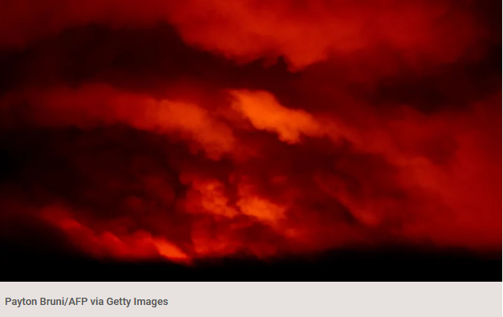
Are there any of the similarities that you can see to where you live in the world?
How familiar are the people, the landscape, the objects or the areas in these images?
How does this image make you feel?

Slide 36
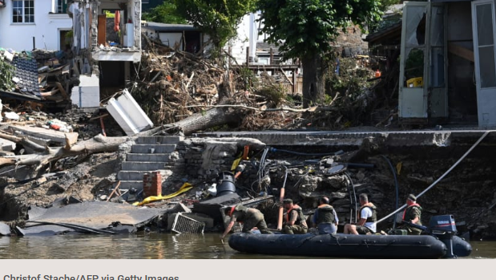
Flooding
Germany

Slide 37
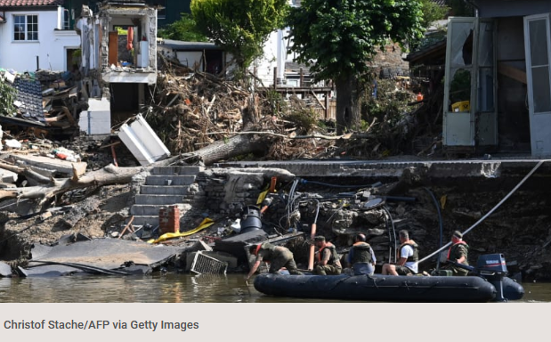
Are there any of the similarities that you can see to where you live in the world?
How familiar are the people, the landscape, the objects or the areas in these images?
How does this image make you feel?

Slide 38


Some ripple effects are often not told about in news stories. As a class, take a couple of minutes to discuss some of these ripple effects of climate change and migration, such as the impact on the more-than-human world.

Slide 39
ECO-EMPATHY
1 0 M I N U T E S

Slide 40
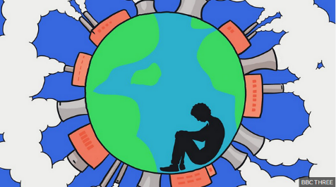
Many people – young people in particular – are struggling with something that is being called ‘eco-anxiety’ or ‘eco-empathy’.
We may be feeling completely overwhelmed by the extent of the climate crisis or feeling very insignificant in being able to make any changes that will have an impact. Or even numb, apathetic, confused…
These feelings are very normal. We feel this way because we care.
Image @ BBC: 'Eco-anxiety': how to spot it and what to do about it

Slide 41
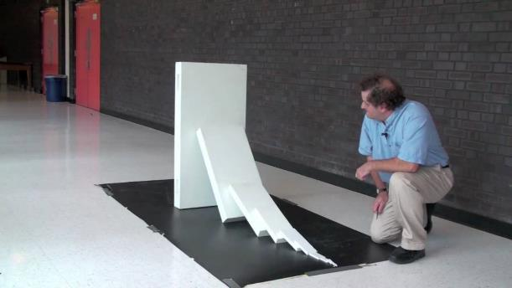
Take a look at the short video (1:10 minutes) made by the American Journal of Physics entitled:
Domino Chain Reaction
(Click on the link above for the hyperlink)
Notes:
Video URL: https://www.youtube.com/watch?v=5JCm5FY-dEY

Slide 42
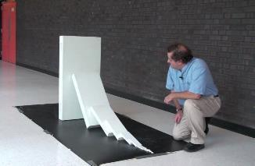
In pairs, take a moment to reflect on the following question:
What does this video tell you about small or individual actions?

Slide 43

Actions we make as individuals may seem small, but they all have huge ripple effects and chain reactions that we may never even know about.
REMEMBER: You are never too small to make a difference.

Slide 44

Just like the animals and creatures we have met, humans will have to – and need to - adapt and make changes to respond to and prevent climate change.
That is why people across the world are changing habits on an individual, local, national and global scale.
Now is a time for creativity and innovation – and there are already amazing things happening across the world! Do you know of any? That’s what we’ll be exploring next lesson!

Slide 45

TURN IDEAS INTO ACTION!
Choose one or do both!
Empathy with others:
Notice as many living beings (human or non-human) that are being impacted by climate change.
Take a moment to empathise how it might be for them.
Brainstorm how these perceptions can influence the way you normally do something in your life.
The small actions:
Notice as many people, groups and actions around you that support the wellbeing of Earth – small or big.
Identify a characteristic that they have in common.
Brainstorm how these can inspire and influence the way you normally do something in your life.

Slide 46

TAKE IT FURTHER
This lesson is part of a wider collection of FREE resources exploring our changing climate.
To access more lessons like this – as well as a wide variety of other topics – simply join the ThoughtBox Hub as a free Explorer Member:
Download FREE resources
Learn more: www.thoughtboxeducation.com/resources

Slide 47

www.thoughtboxhub.com

